Slide 1
Managers -
Managing Summer Hours

Slide 2
Managing Your Employees Time
Time Off Requests
When an employee requests time off you will receive an email notification or you can access your employee time off requests via the Notification Center.
Timecard Edit – Hourly Employees
As a manager you have the ability to edit the timecard and enter the summer hours in the timecard as the employees manager.
Review and Confirm Total Hours
As part of normal processes, you need to make sure the total hours recorded in each of your employees timecards is accurate and all hours are accounted for to ensure accurate payroll processing.

Slide 3
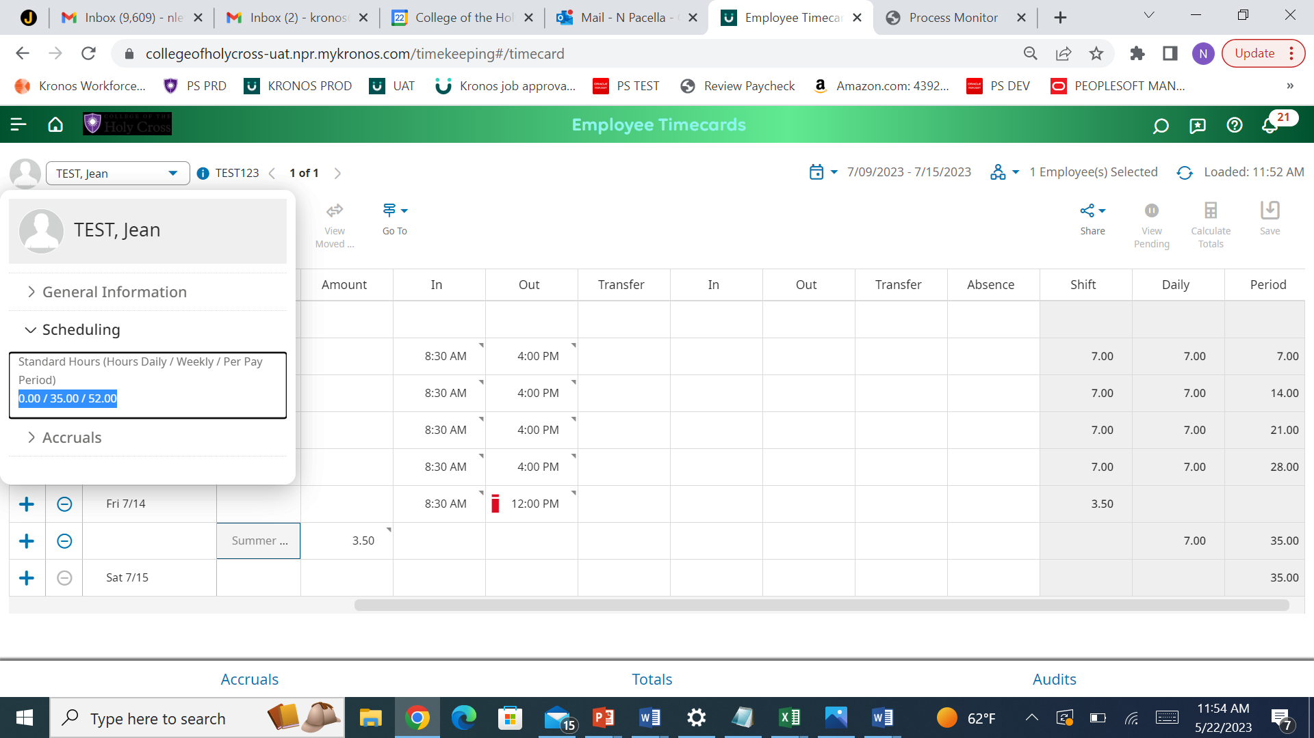
Where to Find an Employees Regular Scheduled Weekly Hours
1. Open Timecard 2. Right Click on Name 3.Expand Scheduling

Slide 4
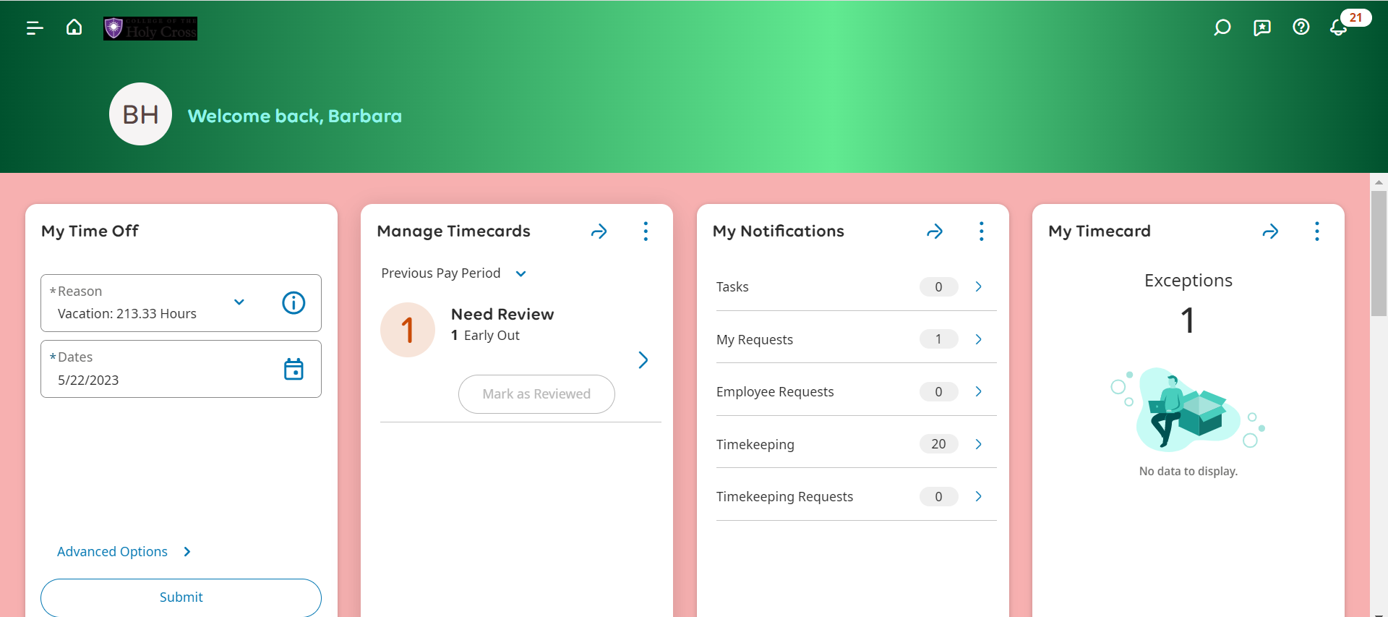
Managing Time Off Requests – Notification Center
Click The Bell Icon, Then View All

Slide 5
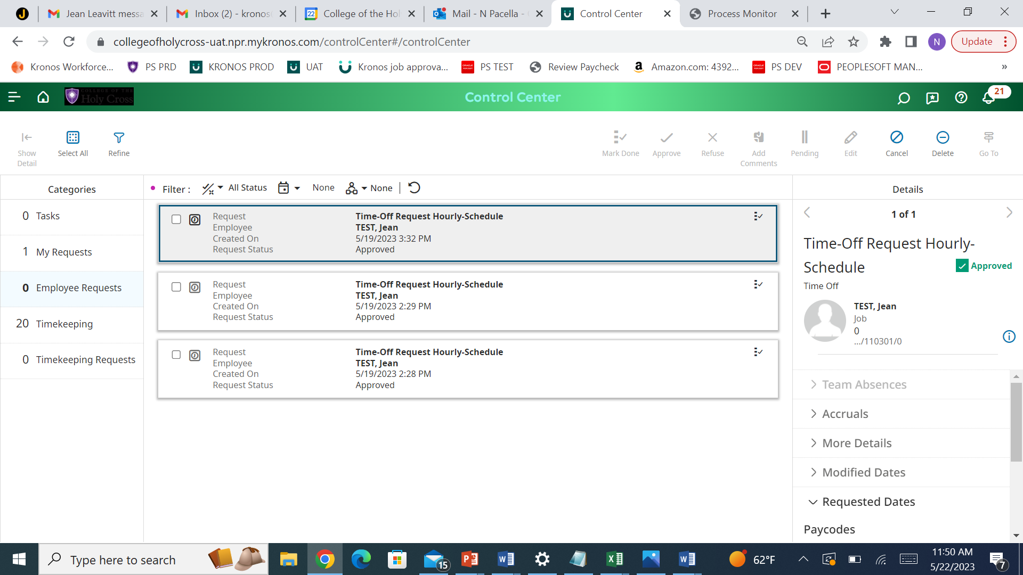
Managing Time Off Requests
1. Category - Employee Requests
3. Check the Box of The Request
2. Filter Icon & Check All

Slide 6
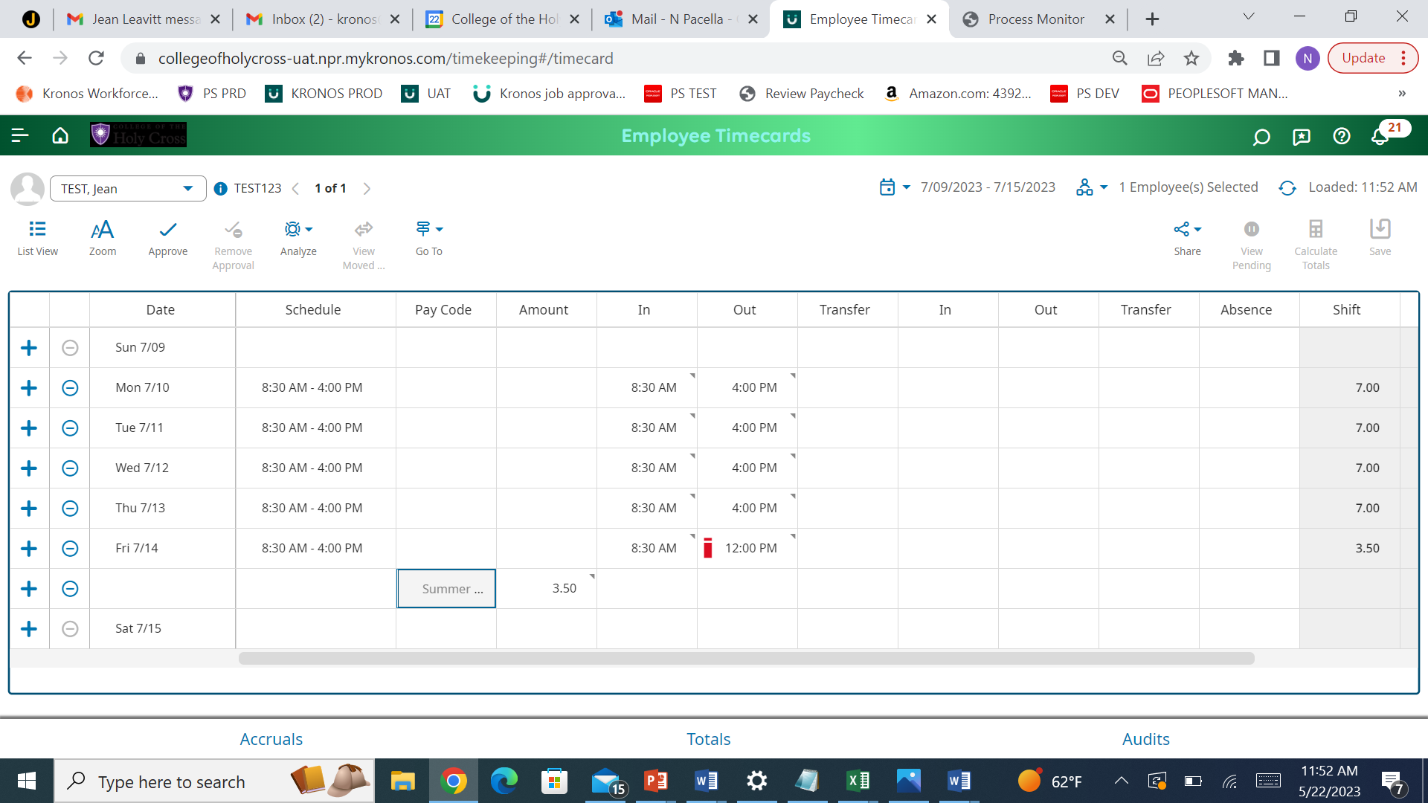
Timecard Edit
1. Use the Summer Hours Pay Code 2. Enter The Number of Hours 3. Save

