Slide 1
Employees – Submit and Confirm a Request for Time Off and Confirm Processing

Slide 2
Managing Your Time
Hourly Employees
Please Submit a Time Off Request
Review and Confirm Total Hours - As part of normal processes, make sure to review your timecard including total hours
Salary Employees
Only action needed – if scheduling 5 days/ 40 hours of time off, you should only be requesting / recording 36 hours of accrued time
.

Slide 3
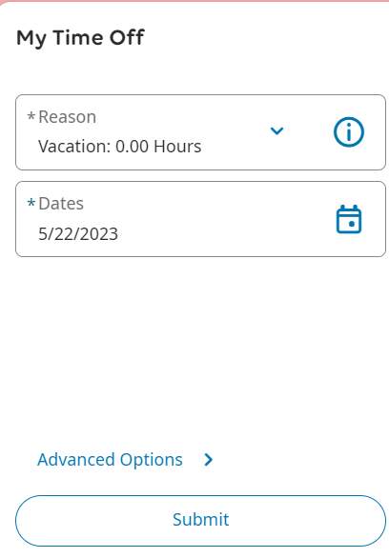
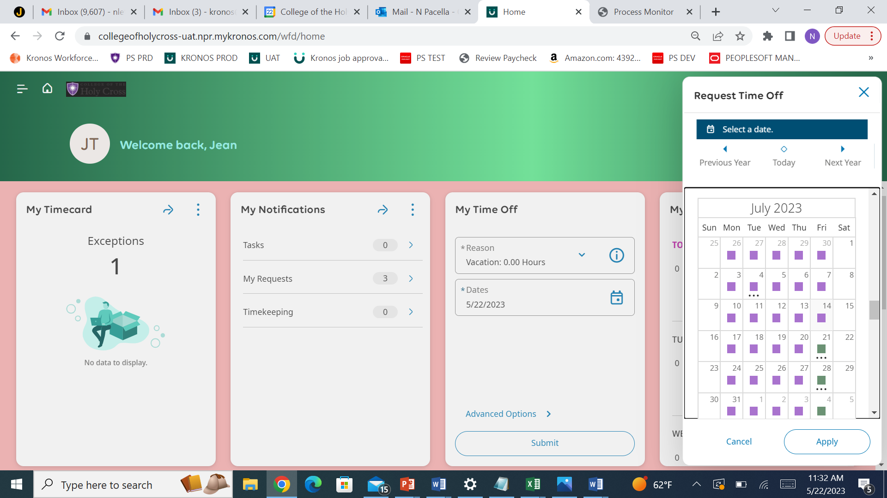
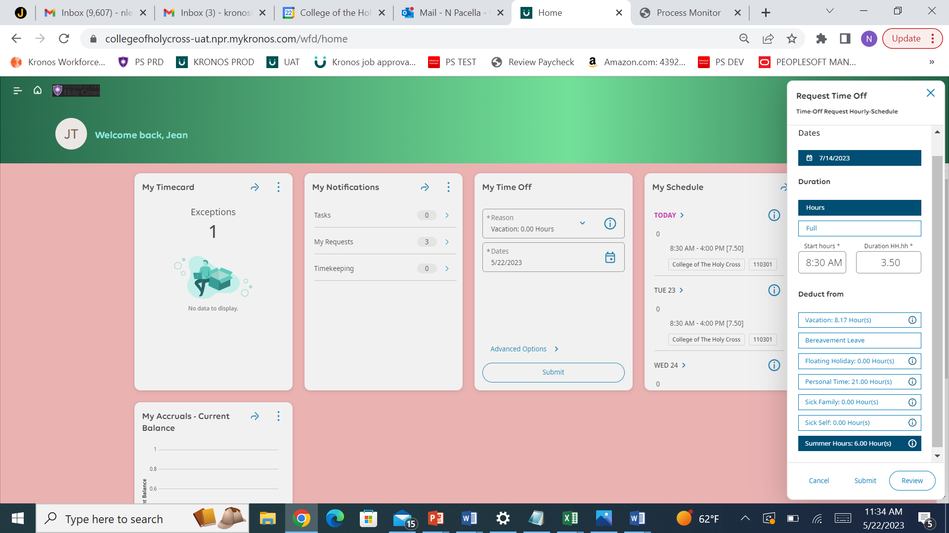
My Time Off - Tile
1. Advanced Options
2. Select a date
3. Enter Start time, Hours, Summer Hours, and Submit

Slide 4
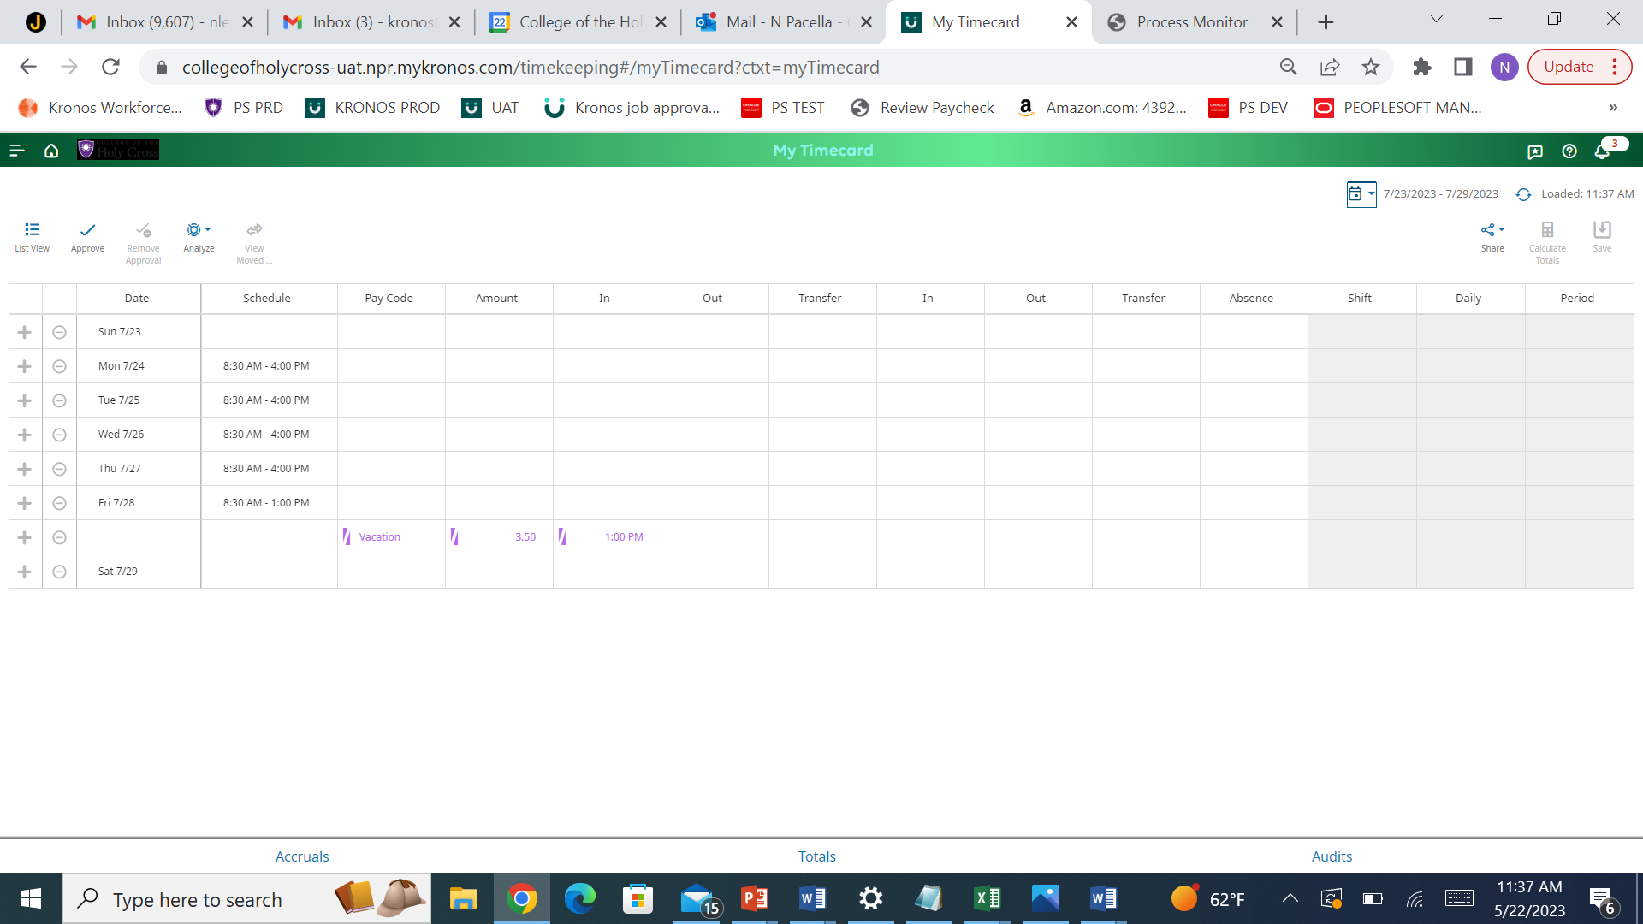
How to Confirm Time is Approved

Slide 5
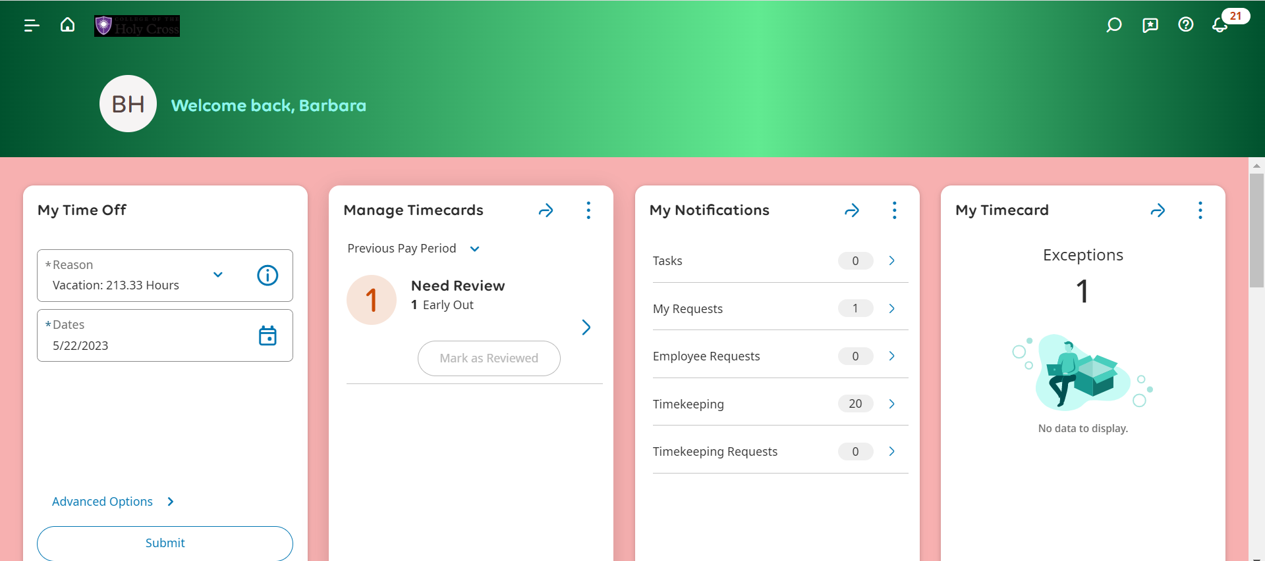
Viewing Your Time Off Requests – Notification Center
Click The Bell Icon, Then View All

Slide 6
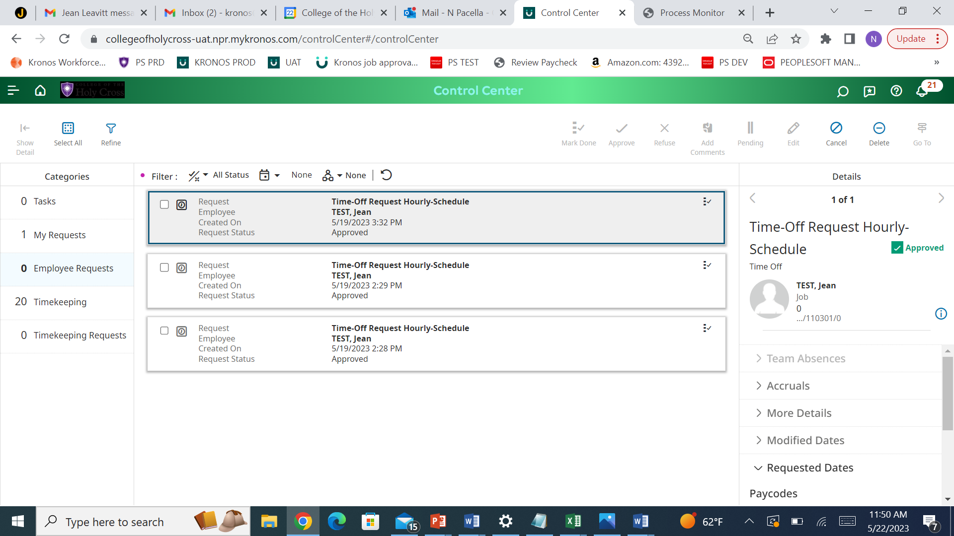
Viewing and Managing Your Time Off Requests
1. Category - My Requests
2. Filter Icon & Check All

